Slide 1
Use Case Diagramm

Slide 2
Agenda
Anwendungsfalldiagramm Allgemein
Das Anwendungsfalldiagramm in der Praxis
Bausteine und Aufbau des Use-Case-Diagramms
Beispiele

Slide 3
ANNOUNCEMENTS
01
IN DEPTH
02
WELCOME!
IN BRIEF
TABLE OF CONTENTS
04
03
EVENTS
05
SNEAK PEEK
06
Here you could describe the topic of the section
Here you could describe the topic of the section
Here you could describe the topic of the section
Here you could describe the topic of the section
Here you could describe the topic of the section
Here you could describe the topic of the section

Slide 4
01
Das Anwendungsfalldiagramm in der Praxis

Slide 5
Das Anwendungsfalldiagramm in der Praxis
Ziel ist es, möglichst einfach Fälle der Anwendungen zu zeigen
Ilustration mittels Strichmänchen dargestellt die auch Akteure heißen
Anwendungsfälle werden in Ellipsen Dargestellt
Systemgrenzen warden durch Rechtecke gekennzeichnet

Slide 6
02
Anwendungsfalldiagramm Allgemein

Slide 7
Anwendungsfalldiagramm Allgemein
Ziel ist es, möglichst einfach Fälle der Anwendungen zu zeigen
Ilustration mittels Strichmänchen dargestellt die auch Akteure heißen
Anwendungsfälle werden in Ellipsen Dargestellt
Systemgrenzen warden durch Rechtecke gekennzeichnet

Slide 8
03
Bausteine und Aufbau des Use-Case Diagramms

Slide 9
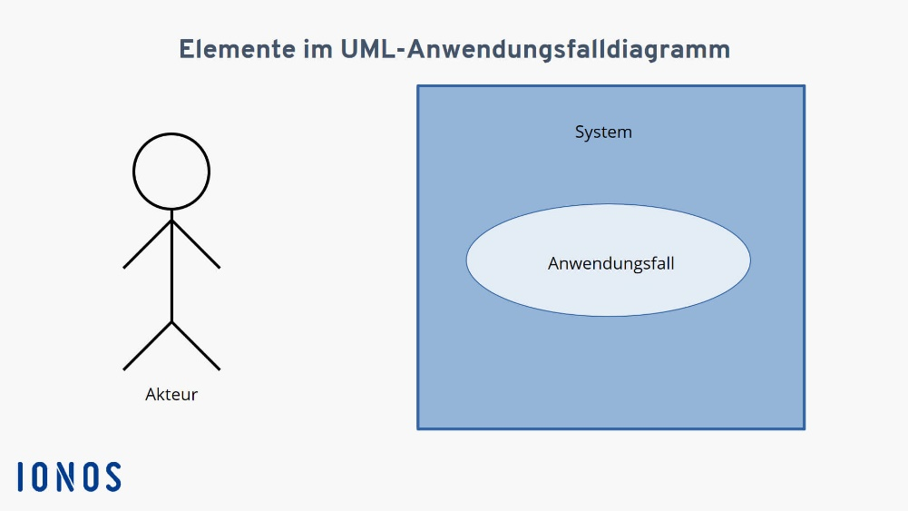
Für Akteuer und Systeme
RICHARD ROE
HELENA PATTERSON
“Neptune is the farthest planet from the Sun and the fourth-largest planet in our Solar System!”
“Despite being red, Mars is a cold place. It’s full of iron oxide dust, which gives the planet its reddish cast”

Slide 10
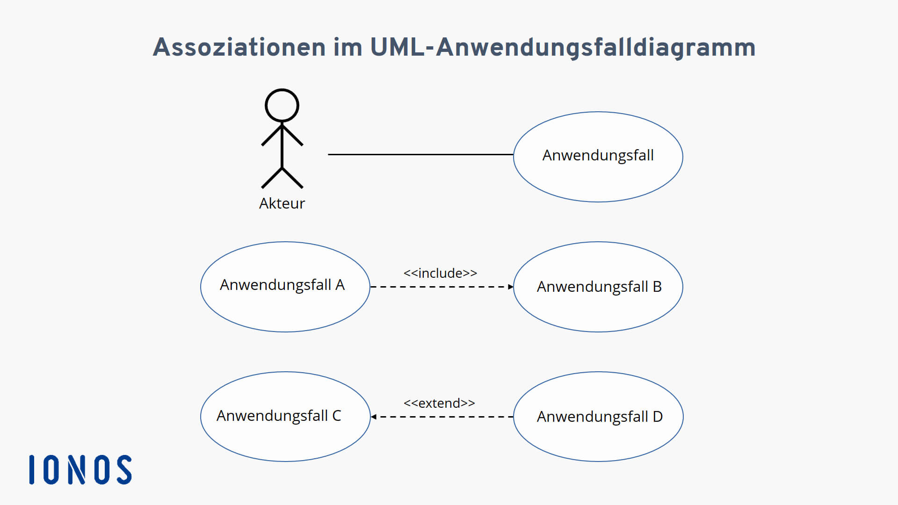

Assoziation im UML- Anwendungsfalldiagramm
MERCURY
Mercury is the closest planet to the Sun and the smallest one in the Solar System—it’s only a bit larger than our Moon.

Slide 11
SECTOR NEWS
VENUS
MARS
SATURN
Despite being red, Mars is a cold place, not hot. It’s full of iron oxide dust, which gives the planet its reddish cast
Venus has a beautiful name and is the second planet from the Sun. It’s terribly hot, even hotter than the other planets
Yes, this is the ringed one. It’s a gas giant, composed mostly of hydrogen and helium. It’s named after the Roman god

Slide 12
04
Beispiele

Slide 13
Danke für eure Aufmerksamkeit

Slide 14
Instructions for use (free users)
In order to use this template, you must credit Slidesgo by keeping the Thanks slide.
You are allowed to:
Modify this template.
Use it for both personal and commercial purposes.
You are not allowed to:
Sublicense, sell or rent any of Slidesgo Content (or a modified version of Slidesgo Content).
Distribute this Slidesgo Template (or a modified version of this Slidesgo Template) or include it in a database or in any other product or service that offers downloadable images, icons or presentations that may be subject to distribution or resale.
Use any of the elements that are part of this Slidesgo Template in an isolated and separated way from this Template.
Delete the “Thanks” or “Credits” slide.
Register any of the elements that are part of this template as a trademark or logo, or register it as a work in an intellectual property registry or similar.
For more information about editing slides, please read our FAQs or visit Slidesgo School:
https://slidesgo.com/faqs and https://slidesgo.com/slidesgo-school

Slide 15
Instructions for use (premium users)
In order to use this template, you must be a Premium user on Slidesgo.
You are allowed to:
Modify this template.
Use it for both personal and commercial purposes.
Hide or delete the “Thanks” slide and the mention to Slidesgo in the credits.
Share this template in an editable format with people who are not part of your team.
You are not allowed to:
Sublicense, sell or rent this Slidesgo Template (or a modified version of this Slidesgo Template).
Distribute this Slidesgo Template (or a modified version of this Slidesgo Template) or include it in a database or in any other product or service that offers downloadable images, icons or presentations that may be subject to distribution or resale.
Use any of the elements that are part of this Slidesgo Template in an isolated and separated way from this Template.
Register any of the elements that are part of this template as a trademark or logo, or register it as a work in an intellectual property registry or similar.
For more information about editing slides, please read our FAQs or visit Slidesgo School:
https://slidesgo.com/faqs and https://slidesgo.com/slidesgo-school

Slide 16
Fonts & colors used
This presentation has been made using the following fonts:
Exo 2
(https://fonts.google.com/specimen/Exo+2)
Roboto Condensed
(https://fonts.google.com/specimen/Roboto+Condensed)
#434343
#eeeeee
#ffffff

Slide 17





Stories by Freepik
Create your Story with our illustrated concepts. Choose the style you like the most, edit its colors, pick the background and layers you want to show and bring them to life with the animator panel! It will boost your presentation. Check out How it Works.
Pana
Amico
Bro
Rafiki
Cuate

Slide 18
Use our editable graphic resources...
You can easily resize these resources without losing quality. To change the color, just ungroup the resource and click on the object you want to change. Then, click on the paint bucket and select the color you want. Group the resource again when you’re done. You can also look for more infographics on Slidesgo.

Slide 21
JANUARY
FEBRUARY
MARCH
APRIL
MAY
JUNE
PHASE 1
Task 1
Task 2
PHASE 2
Task 1
Task 2
JANUARY
FEBRUARY
MARCH
APRIL
PHASE 1
Task 1
Task 2

Slide 24
...and our sets of editable icons
You can resize these icons, keeping the quality.
You can change the stroke and fill color; just select the icon and click on the paint bucket/pen.
In Google Slides, you can also use Flaticon’s extension, allowing you to customize and add even more icons.

Slide 25
Educational Icons
Medical Icons

Slide 26
Business Icons
Teamwork Icons

Slide 27
Help & Support Icons
Avatar Icons

Slide 28
Creative process Icons
Performing Arts Icons

Slide 29
Nature Icons

Slide 30
SEO & Marketing Icons

Slide 31


